Slide 1
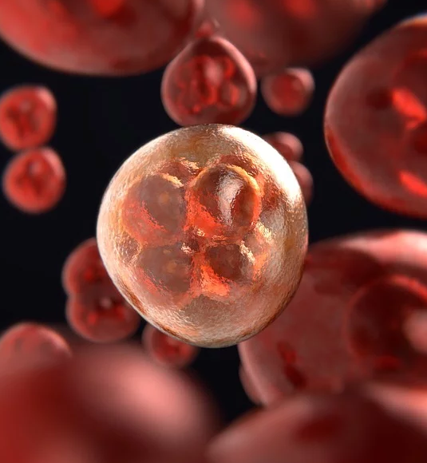







Stages of Mitosis

Slide 2
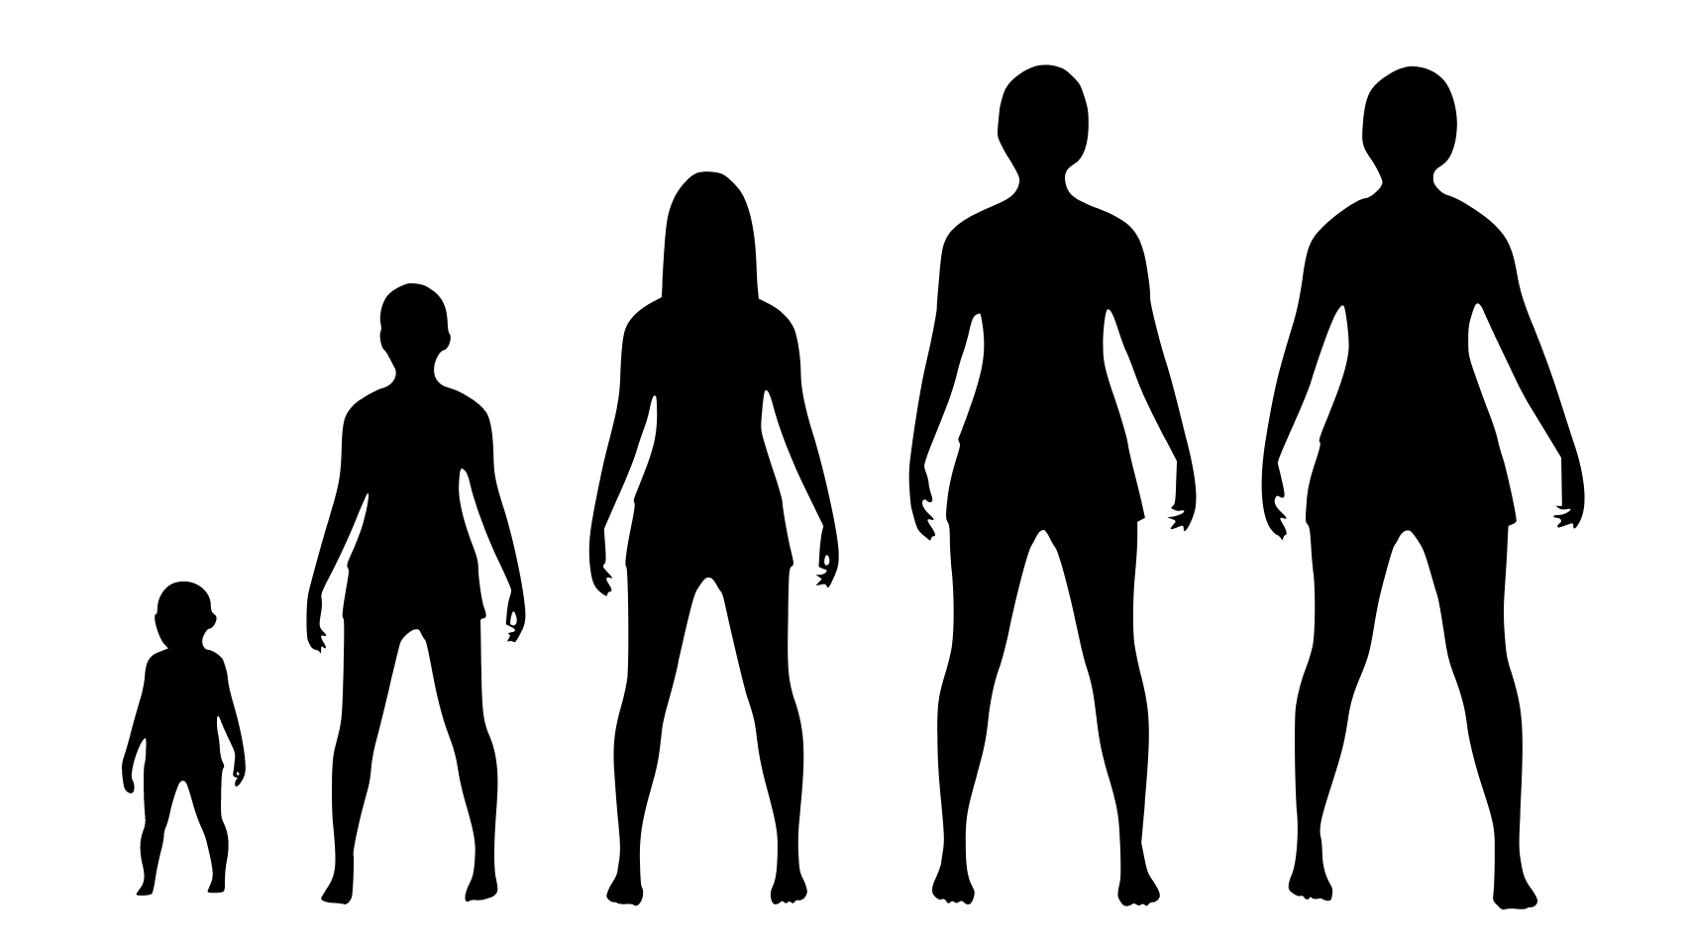
Have you ever wondered how humans or other organisms grow and develop?

Slide 3
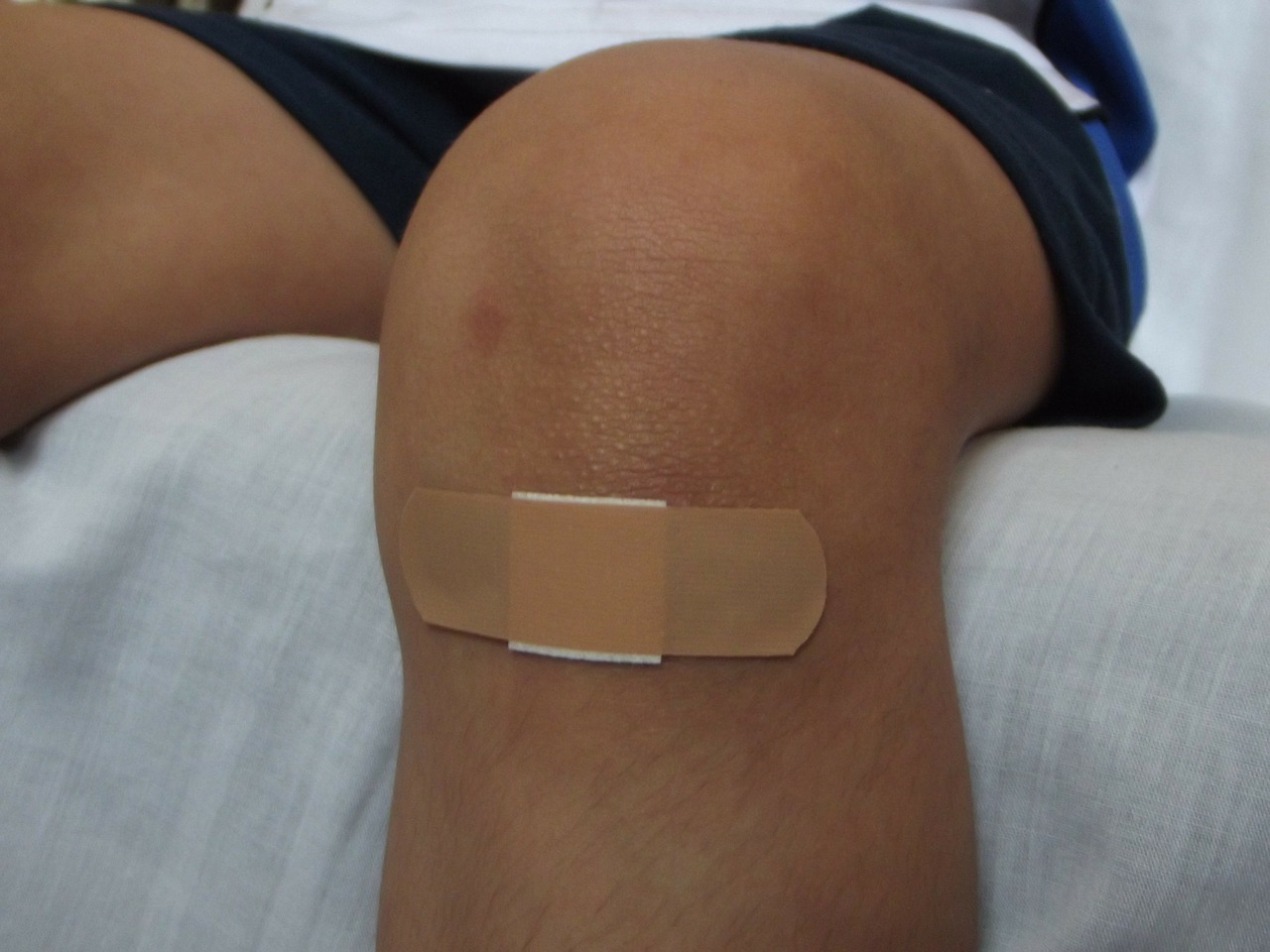
How about healed wounds? How does the wounded skin come back to normal?

Slide 4
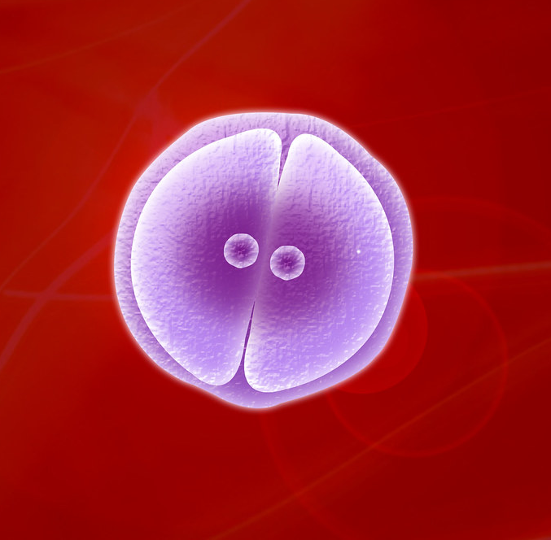
Mitosis refers to how a cell divides to produce new cells.
Only somatic cells (also known as body cells) undergo mitosis.

Slide 5
A cell will only begin mitosis if the conditions are correct and favorable for cell division.

Slide 6
Why is mitosis important for cells? What are the different processes involved?

Slide 7
The Role of Mitosis in the Cell Cycle
The cell undergoes mitosis if it is a somatic cell or meiosis if it is a sex cell.
M Phase
It allows the cell to divide and produce new cells.

Slide 8
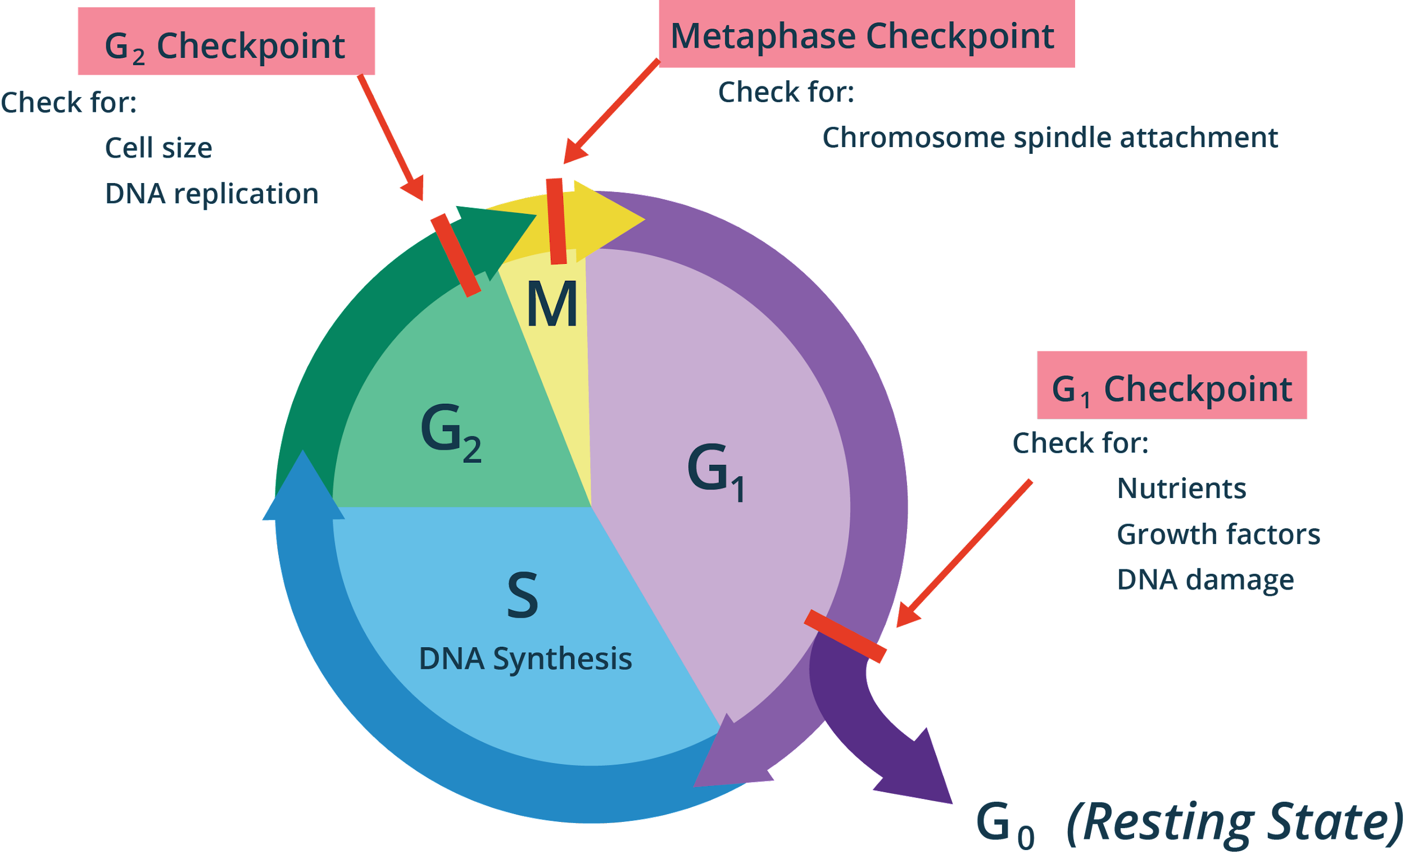
The Role of Mitosis in the Cell Cycle
Preparing for Mitosis:
Cell cycle checkpoints check for errors.

Slide 9
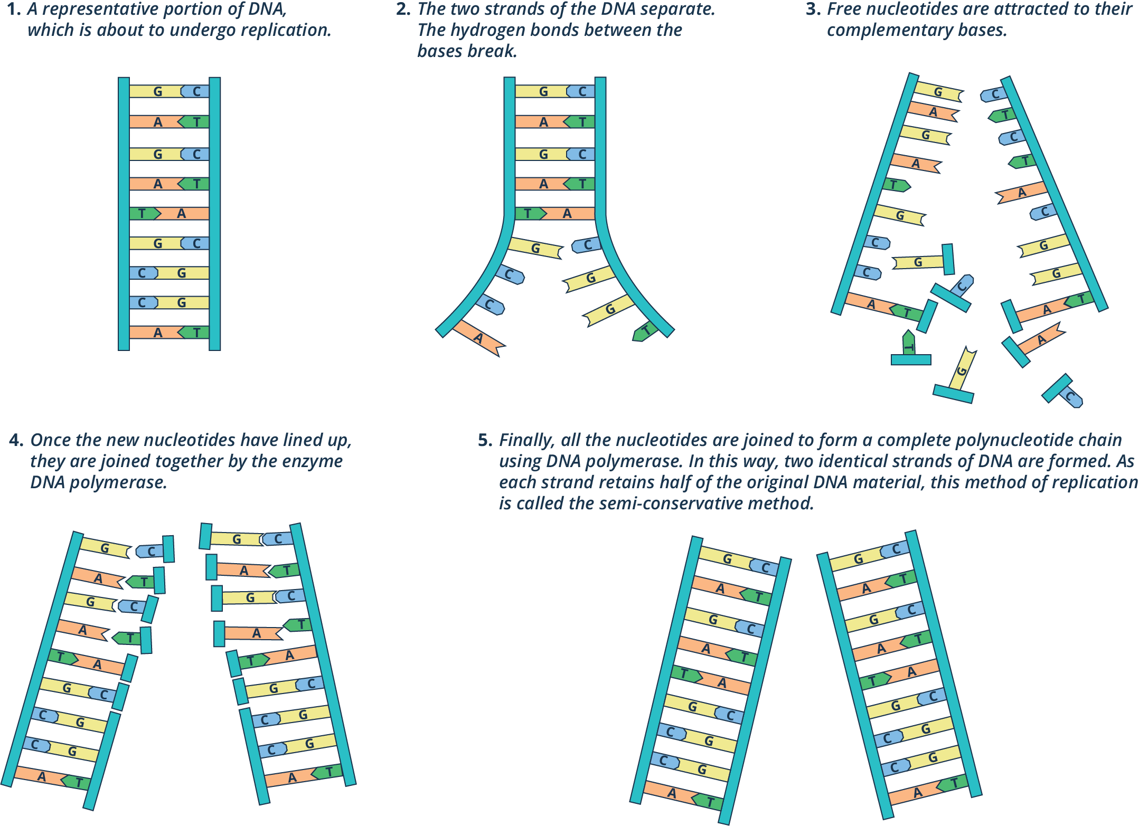
The Role of Mitosis in the Cell Cycle
Preparing for Mitosis:
The synthesis phase involves the duplication of the cell’s DNA.

Slide 10
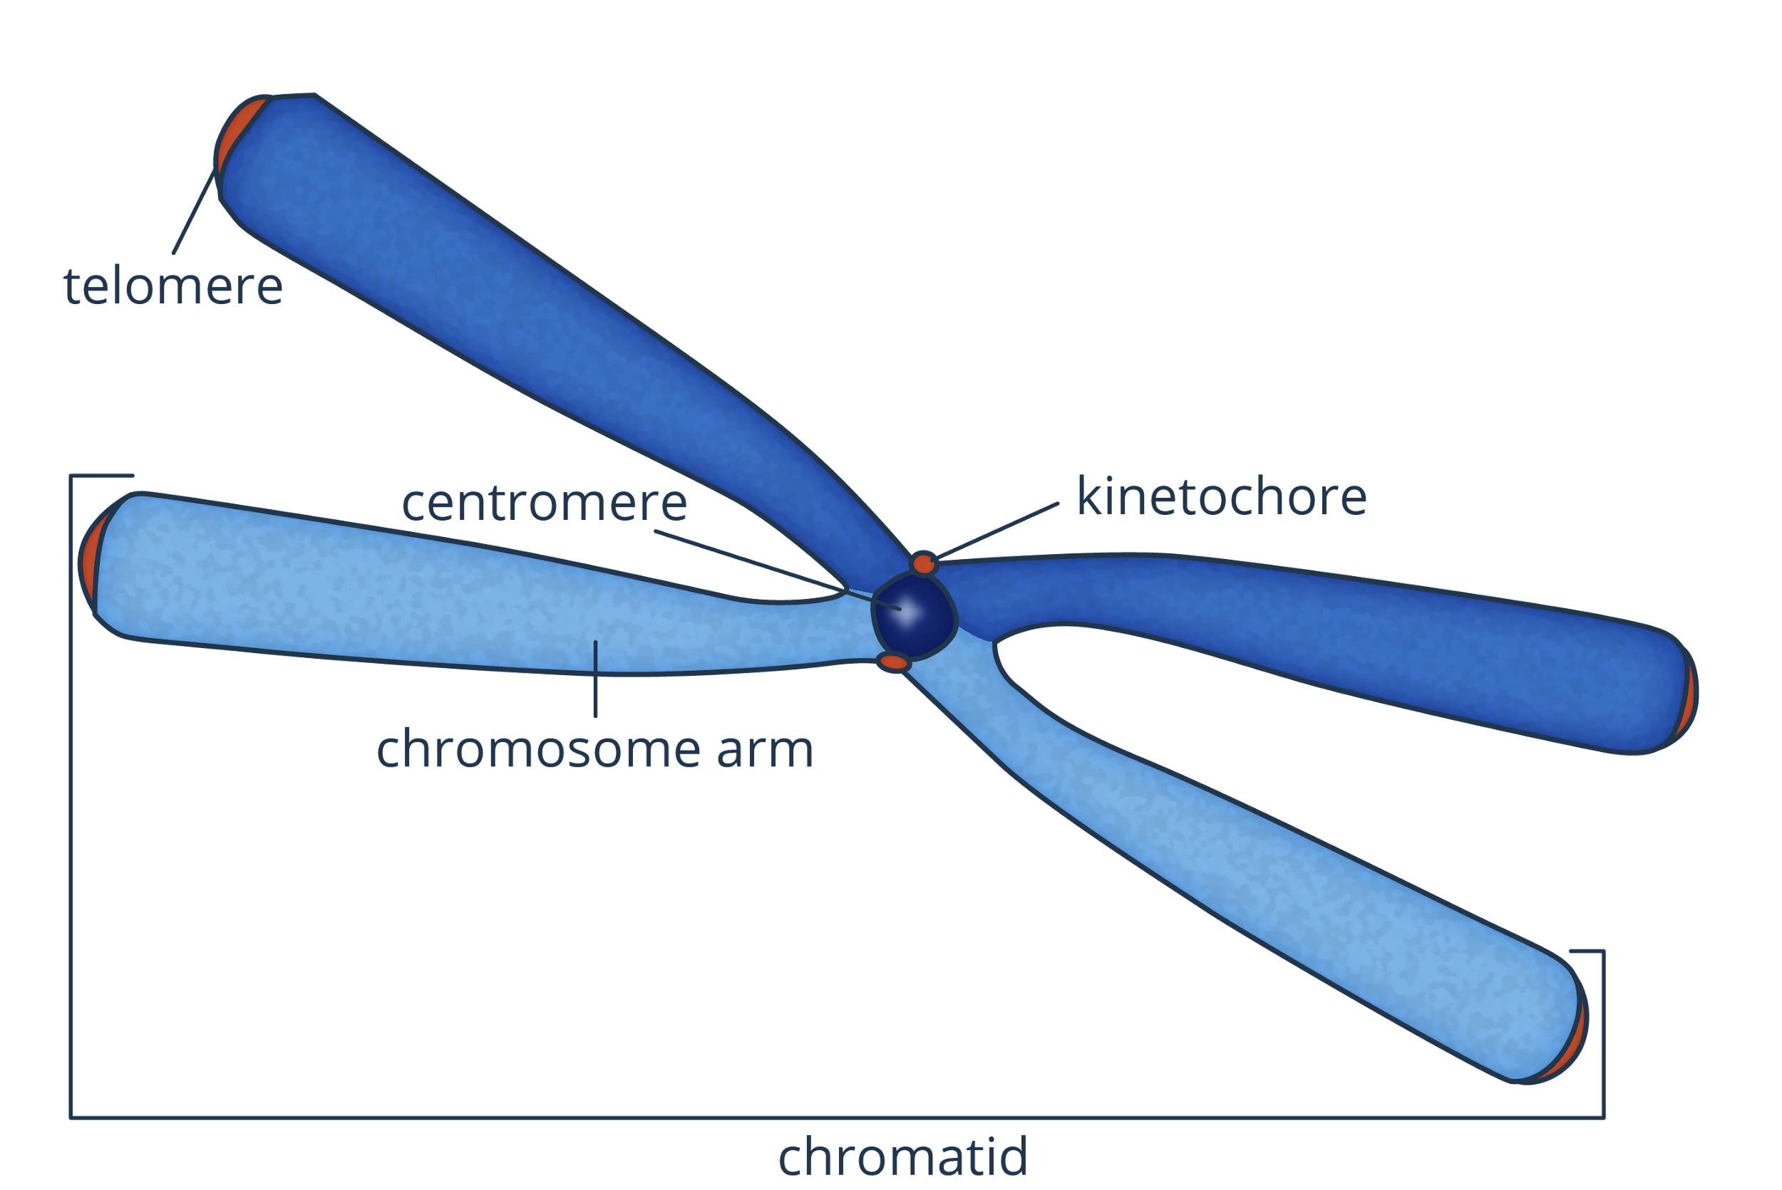
Changes in Chromosome Number during Mitosis
The Chromosome
DNA in interphase is found in the form of chromatin which condenses during mitosis.
Each chromosome is made up of two sister chromatids.

Slide 11
Changes in Chromosome Number during Mitosis
Haploid and Diploid Cells
The human genome has 23 pairs of chromosomes for a total of 46 chromosomes in each cell. 23 is the haploid number whereas 46 is the diploid number.
Haploid is often represented as n while diploid is 2n.
The number of sets of chromosomes that a cell or an organism has is known as ploidy.

Slide 12
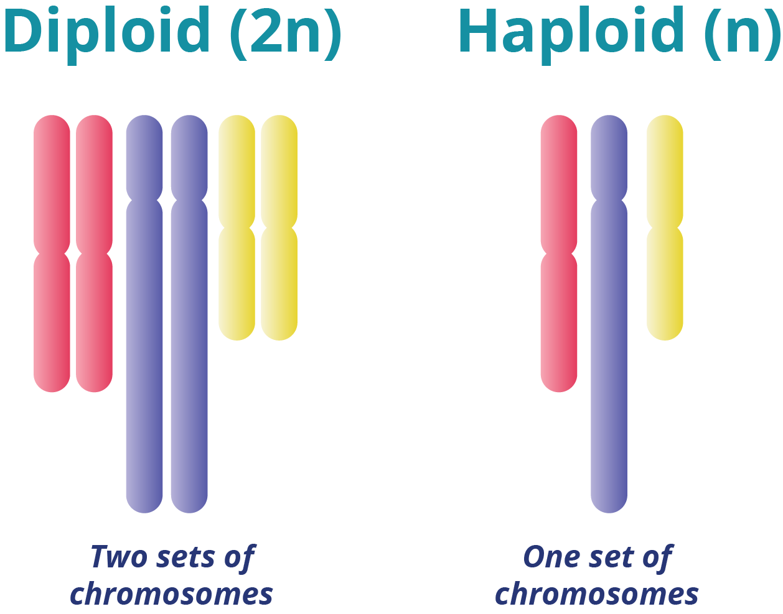
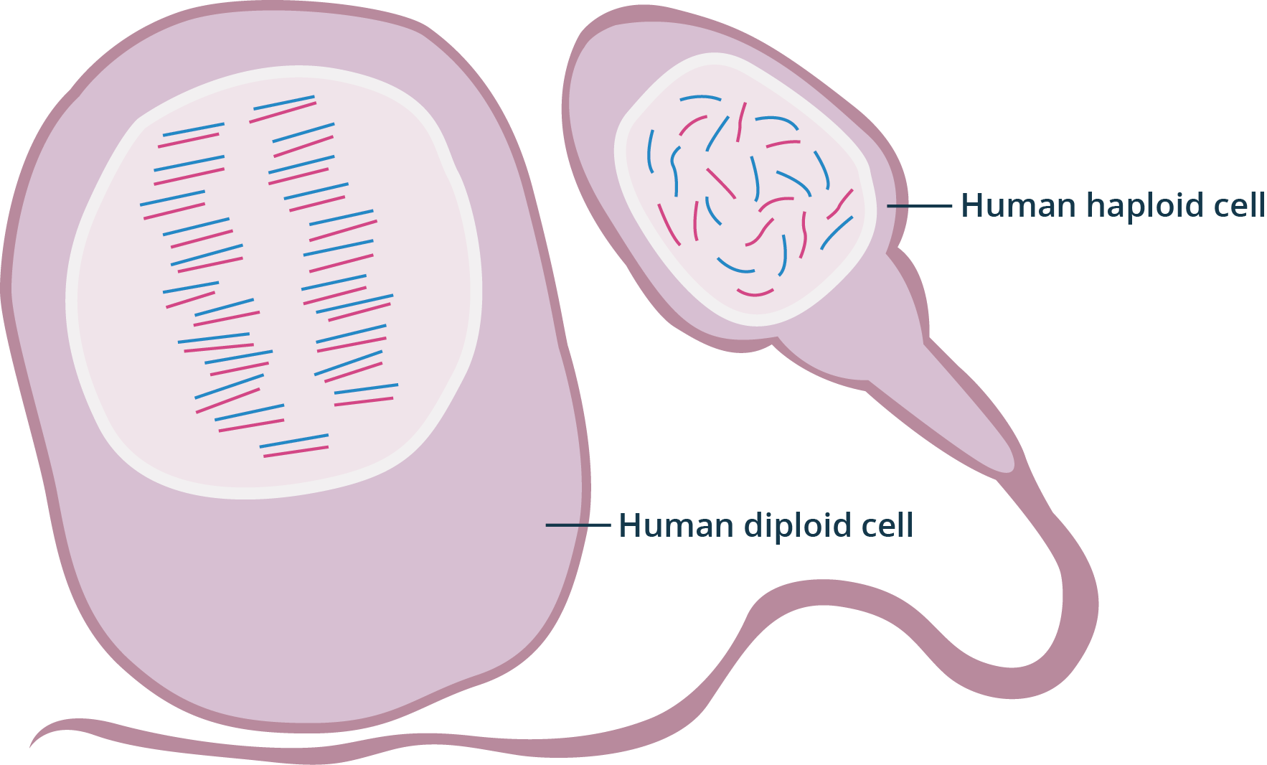
Changes in Chromosome Number during Mitosis
Haploid and Diploid Cells
All human body cells are diploid except gametes which are haploid.

Slide 13
A cell proceeded to mitosis even though its genetic material was not duplicated in the S phase of interphase. What will happen to the daughter cells?

Slide 14
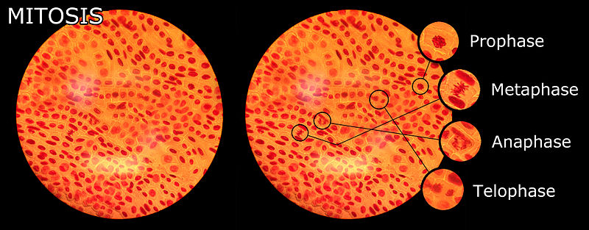
The Phases of Mitosis
Mitosis is also divided into multiple phases.

Slide 15
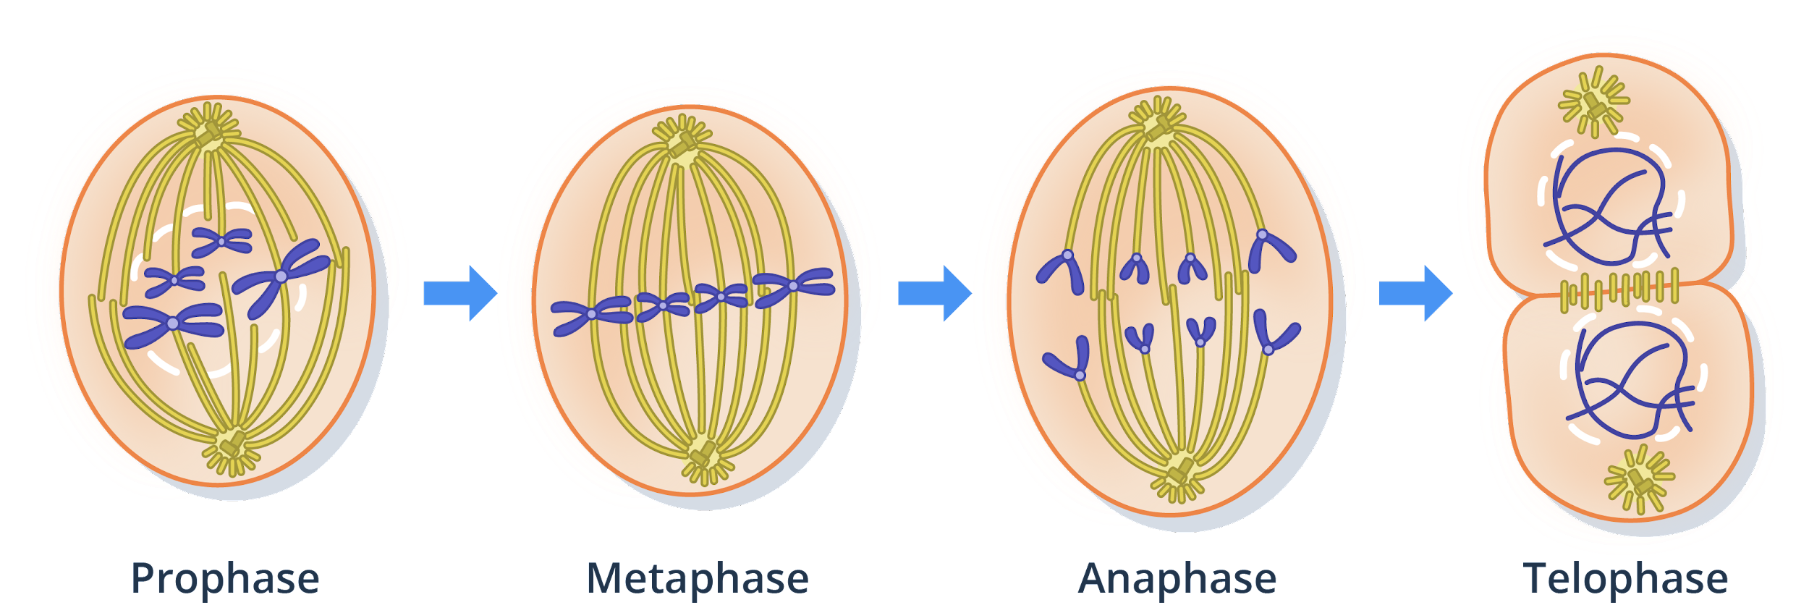
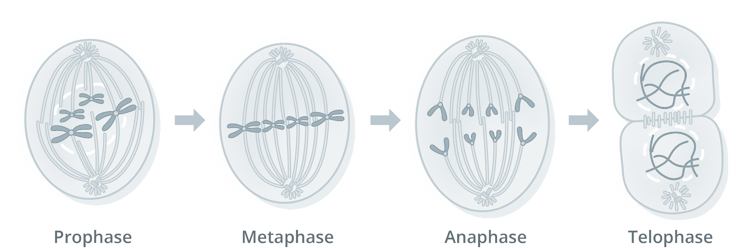
The Phases of Mitosis

Slide 16
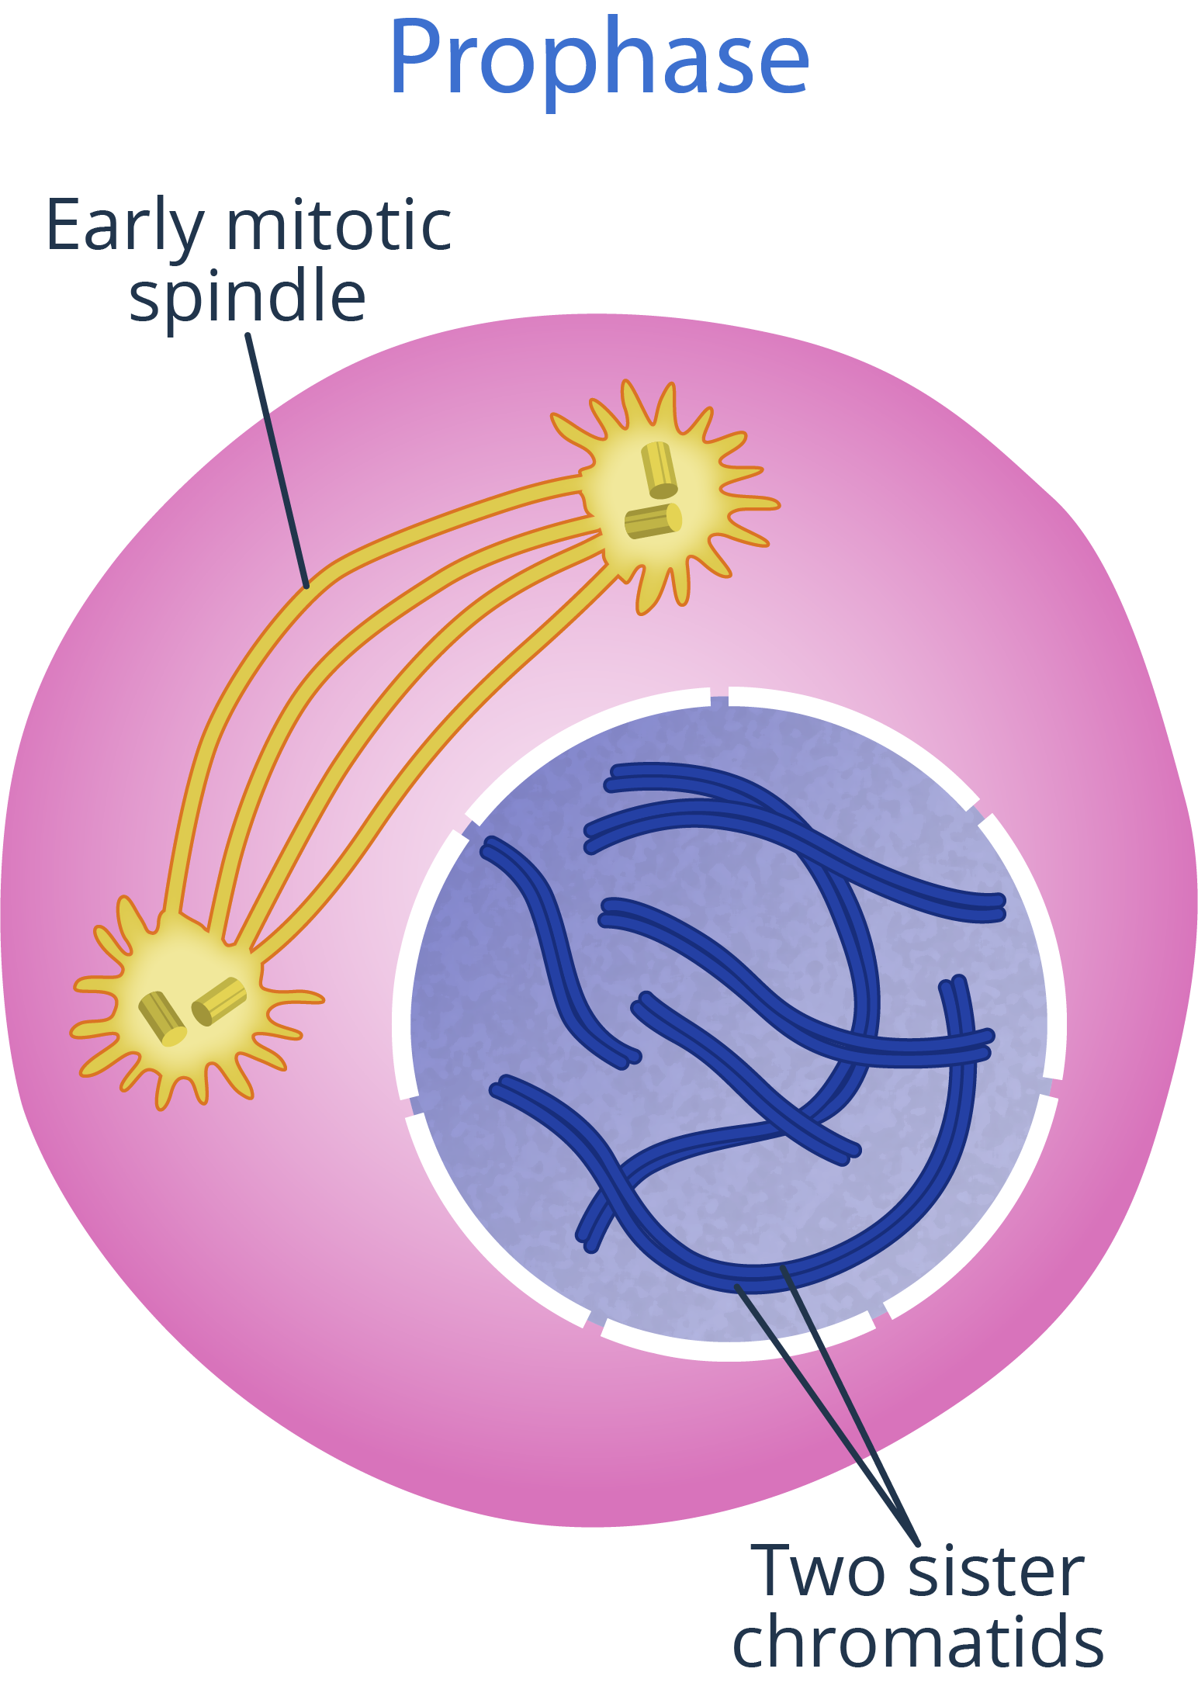
The Phases of Mitosis
The chromatin condense into chromosomes.
The nucleolus disintegrates.
The mitotic spindle starts to form.

Slide 17
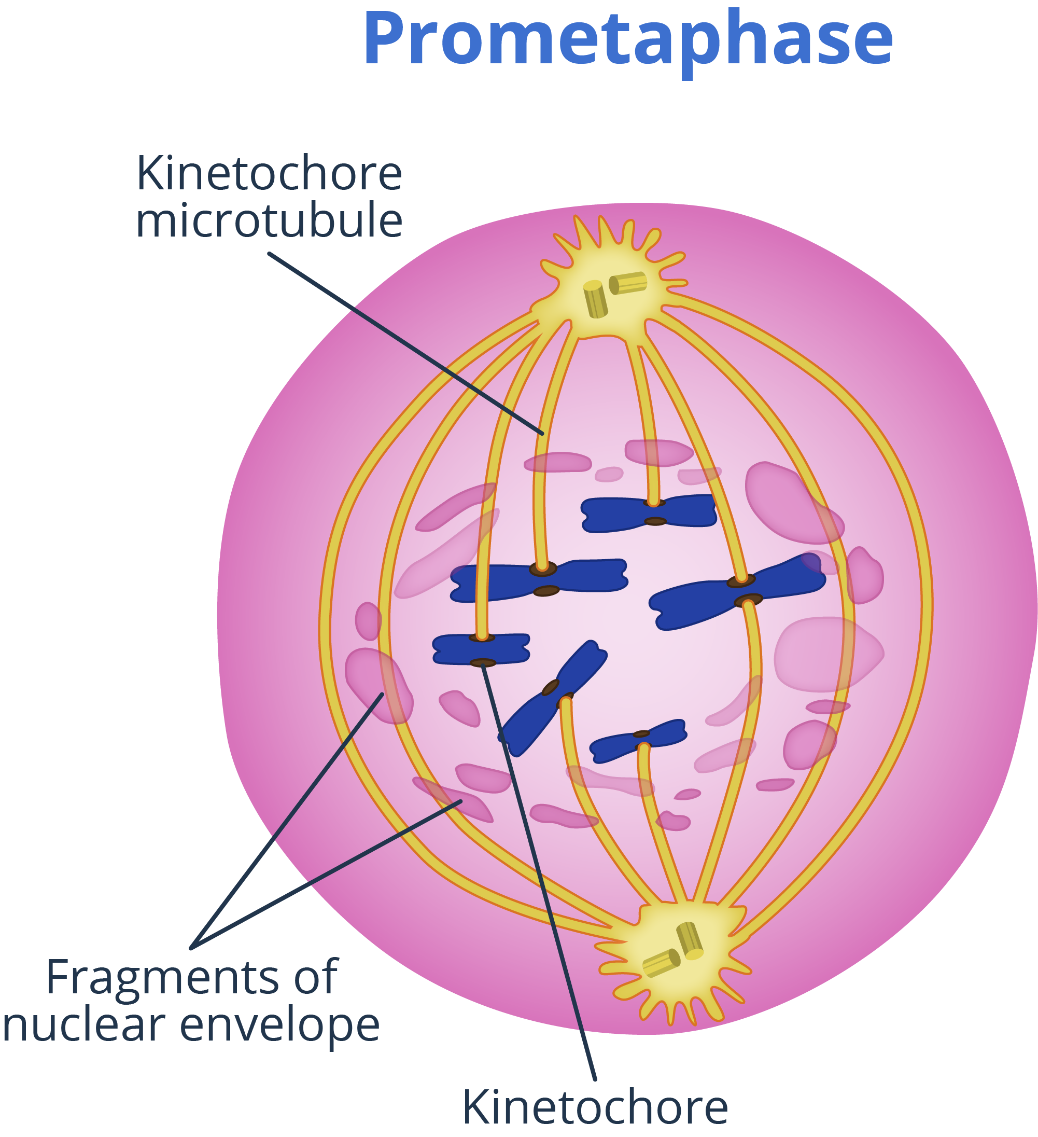
The Phases of Mitosis
It begins after the nuclear envelope breaks down.
The centrosomes move to opposite poles.
The kinetochores found at the centromeres become apparent

Slide 18
The Phases of Mitosis

Slide 19
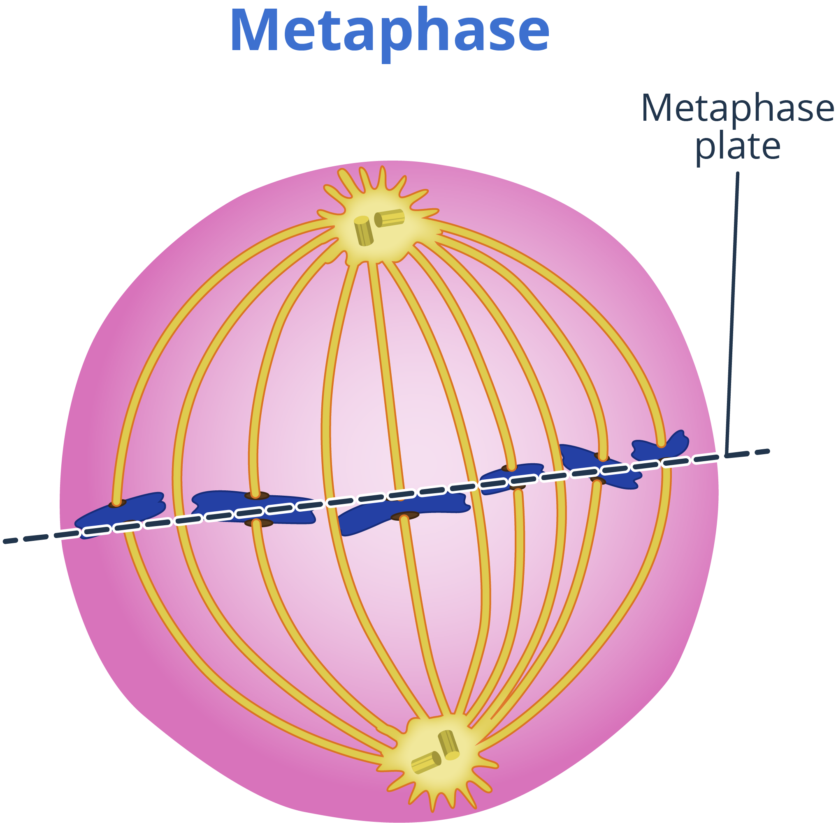
The Phases of Mitosis
The microtubules of the mitotic spindle attach and interact with the kinetochores of the chromosomes.
The chromosomes align at the center of the cell, in the metaphase plate.

Slide 20
The Phases of Mitosis

Slide 21
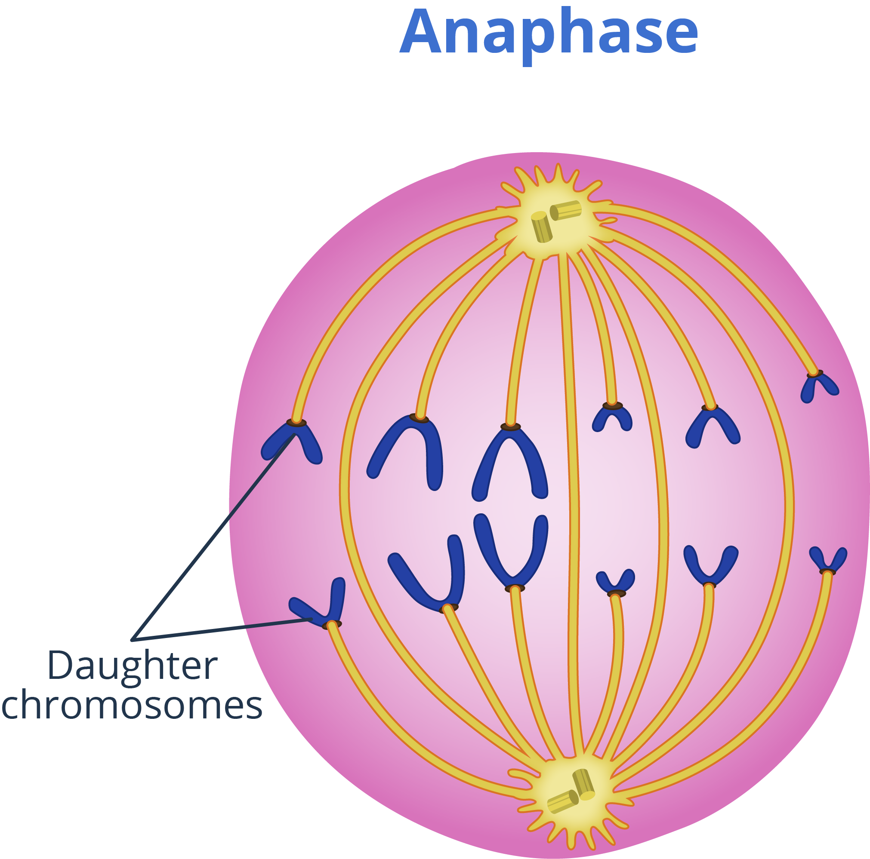
The Phases of Mitosis
The mitotic spindle pulls and separates the sister chromatids apart.
The chromatids, now called daughter chromatids, are then pulled toward the opposite poles.

Slide 22
The Phases of Mitosis

Slide 23
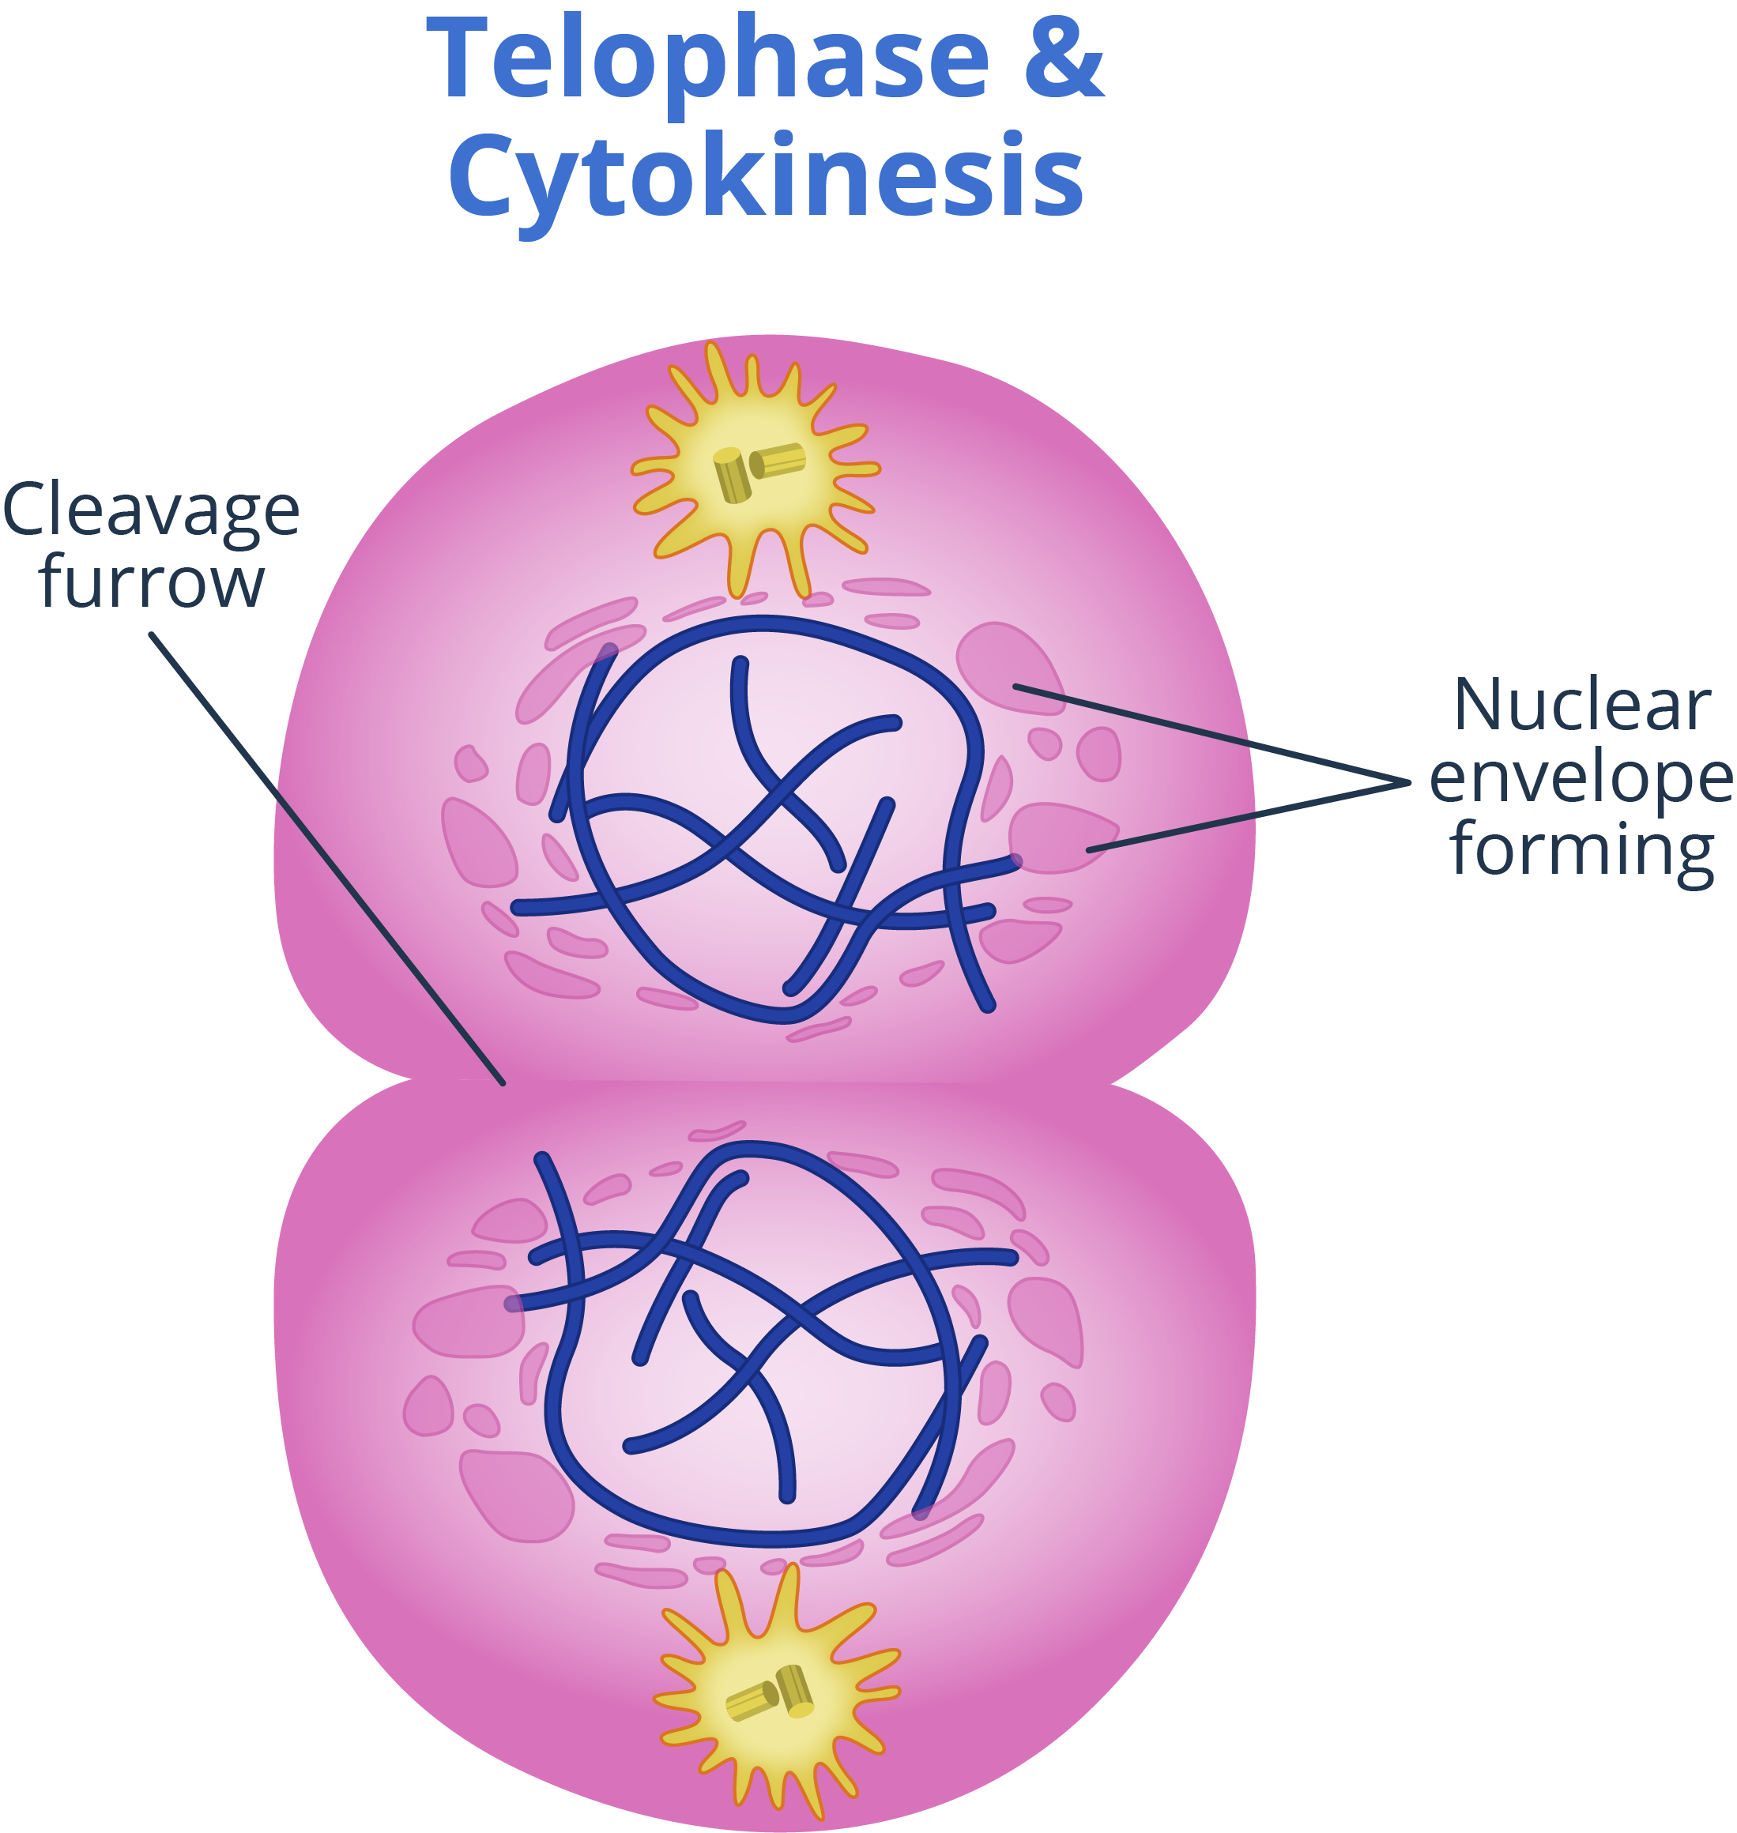
The Phases of Mitosis
Daughter chromatids decondense.
In animals, the boundary of the new cells is known as the cleavage furrow.
In plants, it is known as the cell plate.

Slide 24
When trying to differentiate between the appearance of cells in the different phases of mitosis, remember that the first letter of the phase shares the first letter of what the cell looks like in that phase.

Slide 25
In Prophase, the cell’s genetic material resembles Polka dots or strings.
In Metaphase, the chromosomes Migrate to the Middle of the cell.
In Anaphase, the chromosomes move Away from each other.
In Telophase, the parent cell starts to form Two new cells.

Slide 26
After M phase
Cytokinesis
After telophase, cytokinesis will divide the cell into two.
Cytokinesis is not a phase of mitosis but is closely related to it.
Recall from the previous lesson that each of the two daughter cells will inherit a nucleus, similar genetic material, organelles, and more.

Slide 27
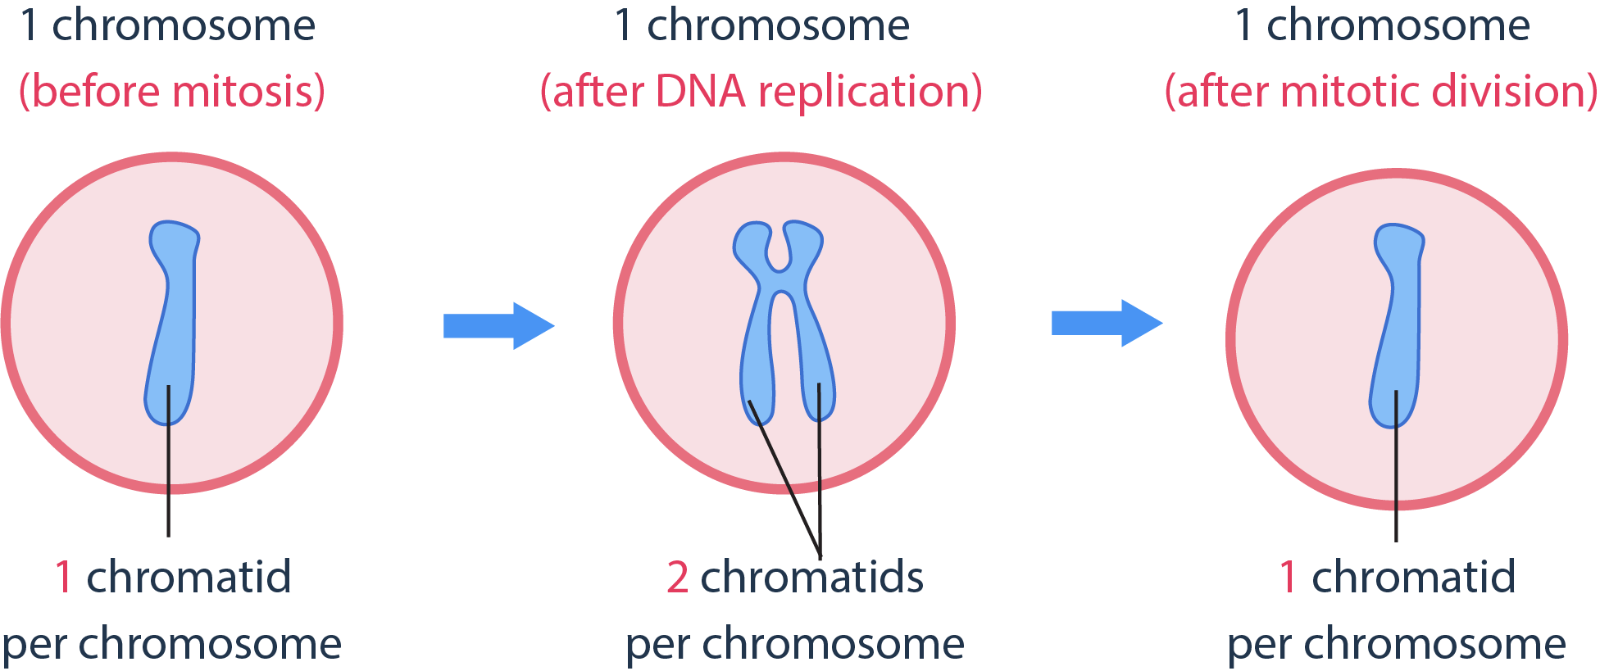
Ploidy in Mitosis
Ploidy in Mitosis
The number of chromosomes before and after mitosis.

Slide 28
DNA is in the form of chromatin in interphase and it condenses into chromosomes during mitosis.
These phases are prophase, prometaphase, metaphase, anaphase, and telophase. Each phase performs a crucial role that contributes to the process of cell division.

Slide 29
Chromosome condensation happens in prophase. Spindle formation also begins.
Prometaphase begins after the completion of the breakdown of the nuclear envelope.
Metaphase involves the alignment of the chromosomes in the metaphase plate.

Slide 30
The sister chromatids move to the opposite poles of the cell in anaphase.
Telophase ends when two nuclei are formed in the cell.

Slide 31
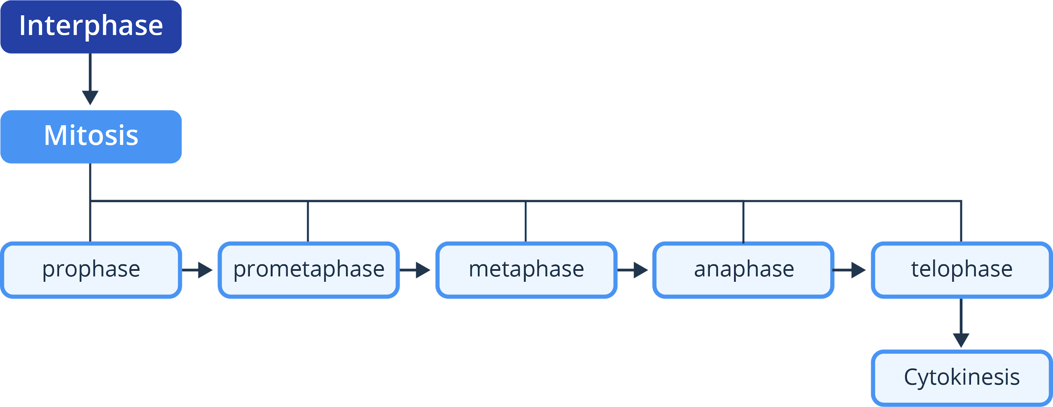
The stages of mitosis

Slide 32
What will happen if the daughter cells do not receive the necessary chromosomes from the parent cell?

Slide 33
Slide 4: Cell division, by Zappy’s Technology Solutions is licensed under CC-BY SA 2.0 via Flickr.
Slide 16: Mitosis in yellow onion cells, by Pixelmaniac pictures is licensed under CC-BY SA 3.0 via Wikimedia Commons.
Boyer, Rodney F. Concepts in Biochemistry. Hoboken, NJ: Wiley, 2006.
Hickman, Cleveland P. Integrated Principles of Zoology. New York, NY: McGraw-Hill, 2011.
Miller, Stephen A., and John P. Harley. Zoology. New York, NY: McGraw-Hill, 2010.
Russell, Peter J. Biology: the Dynamic Science. Student Ed. Belmont, CA: Thomson/Brooks/Cole, 2008.
Starr, Cecie, Ralph Taggart, Christine A. Evers, and Lisa Starr. Biology: the Unity and Diversity of Life. Boston, MA: Cengage, 2019.

